Slide 1
Case Study Polls
WVSHA 2019

Slide 2
Case Study 1: CF Mentor MIA
https://tinyurl.com/wvsha-1

Slide 3
Case Study 2: Can You Swallow This?
https://tinyurl.com/wvsha-2

Slide 4
Case Study 3: The New Job
https://tinyurl.com/wvsha-3

Slide 5
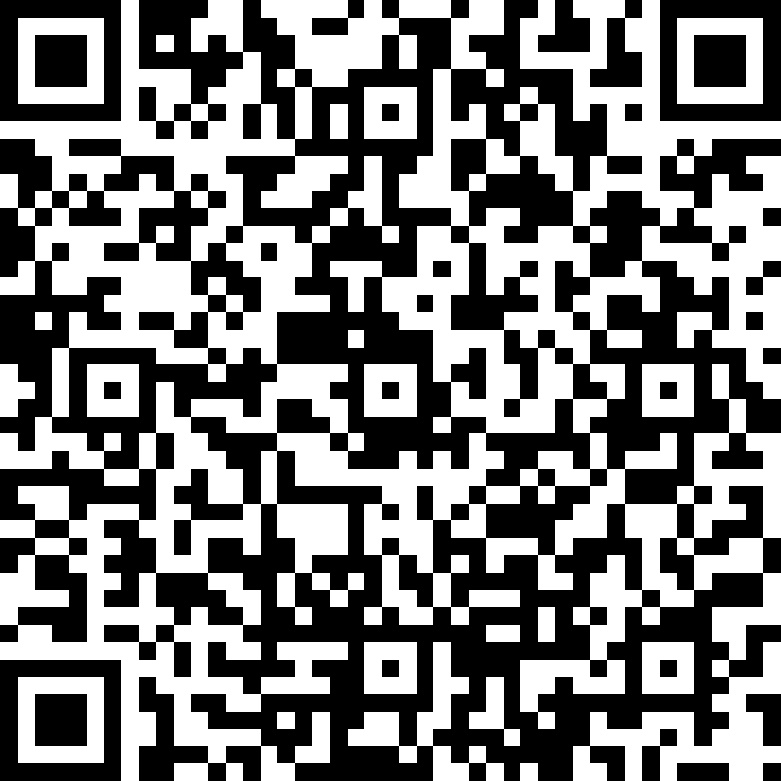
Case Study 4: Early Intervention SLP Diagnoses Sleeping Infant
https://tinyurl.com/wvsha-4

Slide 6
Case Study 5: Appropriate Assessments
https://tinyurl.com/wvsha-5

Slide 7
Case Study 6: Supervision of a Speech-Language Pathology Assistant
https://tinyurl.com/wvsha-6

Slide 8
Case Study 7: Hearing Screening Results
https://tinyurl.com/wvsha-7

Slide 9
Case Study 8: Private Therapy after Work Hours
https://tinyurl.com/wvsha-8

Slide 10
Case Study 9: Bilingual Services
https://tinyurl.com/wvsha-9

Slide 11
Case Study 10/11:SNF Resident Disagrees with Diet Recommendation/Dysphagia Concerns
https://tinyurl.com/wvsha-10-11

Slide 12
Case Study 12: Wedding Jitters
https://tinyurl.com/wvsha-12

